Slide 1
Digital Interfaces and Basic PIC-C I2C Communication
Arnan (Roger) Sipitakiat
Department of Computer Engineering, Chiang Mai University, Thailand

Slide 2
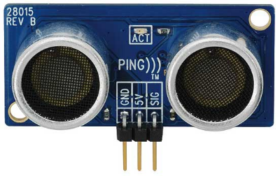
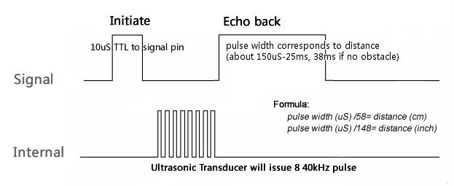
Why I2C? Case study of how an Ultrasonic Proximity Sensor works

Slide 3
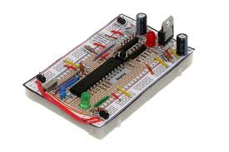

Direct Connection to the module You need to do all the timing yourself
Implement timing

Slide 4
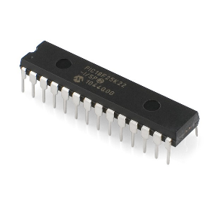
Offload to an I2C Host
Let an I2C host perform the timing
I2C
Take care
of timing
This idea is similar to software abstraction where you create subroutines to hide unnecessary details

Slide 5
Tradeoffs of offloading
Benefits
The sensor is simpler to use.
The main processor is free to do other things.
More modular.
Drawbacks
More expensive
Must be careful of timing problems on the I2C host

Slide 6
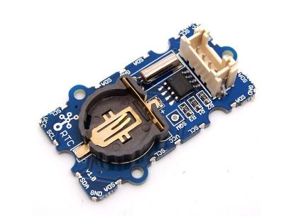
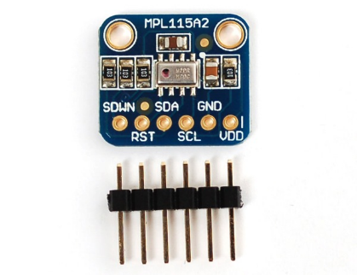
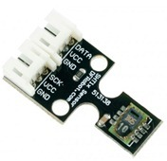
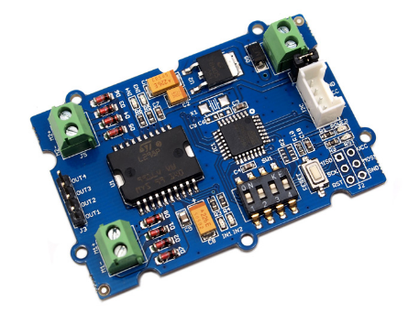
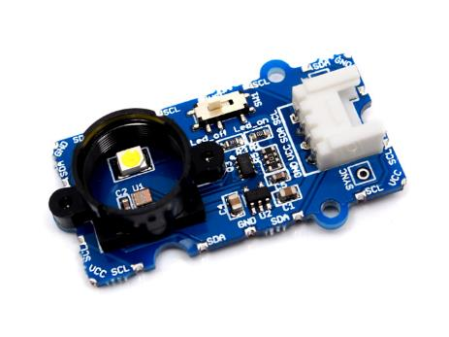
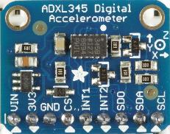
Example 3: I2C devices on the market
Digital Clock
Barometer
Temperature & RH
Color Sensor
Accelerometer
Motor Driver

Slide 7
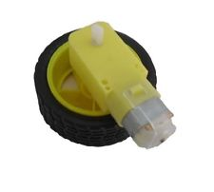

Motor Driver Module
Register Address | Function
0x82 | Speed (0-255)
0x84 | PWM Frequency
0xAA | Direction (0/1)
0xA1 | Select Motor A (0/1)
0xA5 | Select Motor B (0/1)

Slide 8
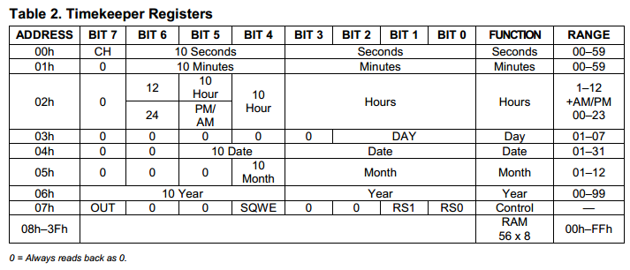

Clock Module Module address = 0xD0

Slide 9
Bitwise Operations

Slide 10
I2C Basics
I2C is a Bus. Serial is point-to-point
Master and Slave pair
Master must start the communication
Slave can only respond
Slave has a 8-bit address
Bit 0 is reserved for direction control

Slide 11
Basic I2C Bus Setup
5V
MASTER
SLAVE 1
SLAVE 2
Pull-up Resistors
SDA
SCL

Slide 12
i2C Commands in PIC-C
Master Only
I2c_start()
I2c_stop()
Slave Only
I2c_isr_state()
Master & Slave
I2c_read()
I2c_write()

Slide 13
Sending 1 Byte to Slave
MASTER
SLAVE
I2c_start()
I2c_write(slave addr | 0)
I2c_write(registerAddress)
I2c_write(value)
I2c_stop()
Address | Content
0 | 0
1 | 0
2 | 0
3 | 0
4 | 0
5 | 0
6 | 0
7 | 0

Slide 14
Reading 2 bytes from slave
MASTER
SLAVE
I2c_start()
I2c_write(slave addr | 0)
I2c_write(registerAddress)
I2c_start()
I2c_write(slave addr | 1)
Value1 = I2c_read()
Value2 = I2c_read(0)
I2c_stop()
Address | Content
0 | 0
1 | 0
2 | 0
3 | 0
4 | 0
5 | 0
6 | 0
7 | 0

Slide 15
Write ค่า 50 ไปยัง Register 5 ของ slave ที่มี address = 100
I2c_start();

Slide 16
Write ค่า 1000 ไปยัง Register 5 (ไบท์บน), 6 (ไบท์ล่าง) ของ slave ที่มี address = 100
I2c_start();

Slide 17
Read ค่าจาก Register 5 ของ slave ที่มี address = 100
Int returnValue;
I2c_start();

Slide 18
Read ค่าเซ็นเซอร์ 2 byte จาก Register 5,6 ของ slave ที่มี address = 100 และนำมาประกอบกันเป็นค่า int 16 Bit Register 5 = byte บน
Int16 Value;
I2c_start();

Slide 19
Example I Controlling the Display Module Address = 0xB0
Register Address | Function
2 | High Byte
3 | Low Byte

Slide 20
Example Program
// i2c1 - Master
#use i2c(MASTER, I2C1)
// Show the number 100 on the screen
I2c_start();
I2c_write(0xB0 | 0); // display module address
I2c_write(2); // show number command
I2c_write(0);
I2c_write(100);
I2c_stop();

Slide 21

Example II Reading from the ultrasonic sensor

